Slide 1
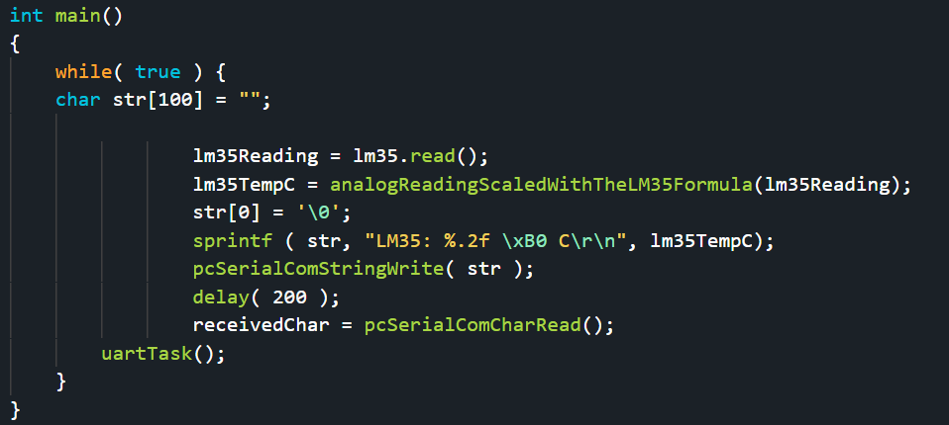
Embedded Systems Lab Worksheet
Student Name: Zeyad Karima
ID Number: 23077460
Lab. Number: 4
Date: 23/03/2025
Lab Title:
Outline of Approach (Description of Tasks)
Itemize all key steps you took to build the required embedded system in a clear, logical and organised format.
1. Continuously read temperature sensor and output on serial monitor
2. Continuously read potentiometer and output on serial monitor
3. Continuously read gas sensor and output on serial monitor when it detects the gas or doesn't
4.Display what type of alarm is set off
.
.
.
Reflection (Not more than 200 words)
I created a code to read and understand the sensor readings of gas and temperature sensor and also a potentiometer.
It was good to understand how to read values from sensors and implement them into the code of the serial monitor.
The good part was the LM35 temperature sensor and potentiometer they were easy to understand and wire, the gas sensor was hard to wire and the codding for it was a little complicated, I decided to use analog to read the gas sensor and identify the sensitivity, also my buzzer did not seem to work so I connected to a pmw pin output allowing me to control it properly.
In this situation a lot of the sensor and also the buzzer were not working properly but I was able to find a way to make it work.
Ive learned how to use pmw, how to connect sensors, how to read sensor values and how to output them properly on the serial monitor.
I am going to understand the sensor outputs to more efficiently input values and read them.
Github with video evidence: https://github.com/ZeyadK05/Lab-4
Results for Part:1
(Input only lab results, Git-hub code link, Flow chart, calculations or picture evidence of simulation/circuits/figures obtained).
All figures should be captioned with relevant title and a brief description to present the essential details).
By reading the lm35 then converting to degrees celsius using the function, then converting the float number into string to output into the monitor we can continuously show the temperature.
References
Reference guide here

Slide 2
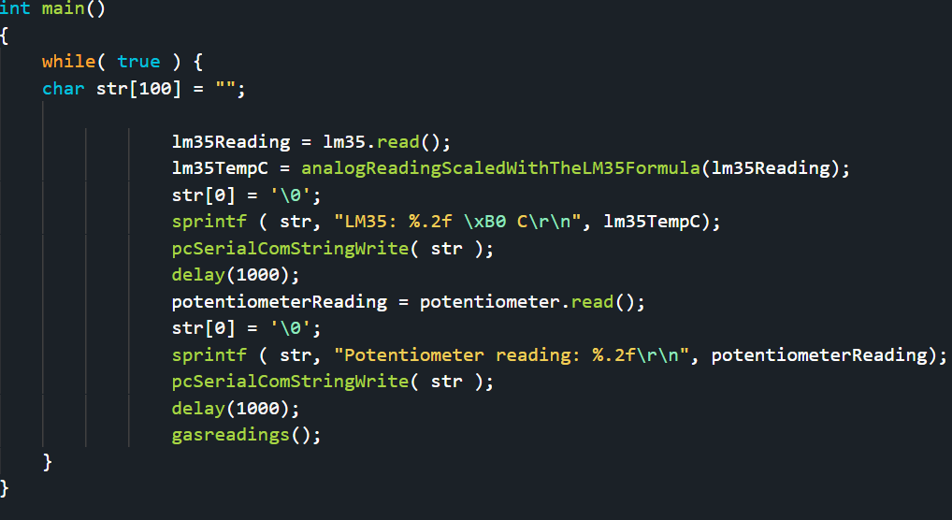
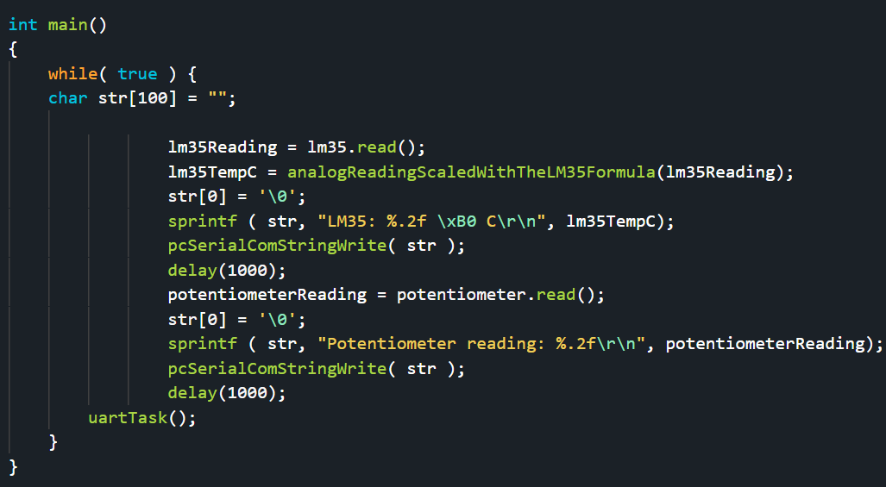
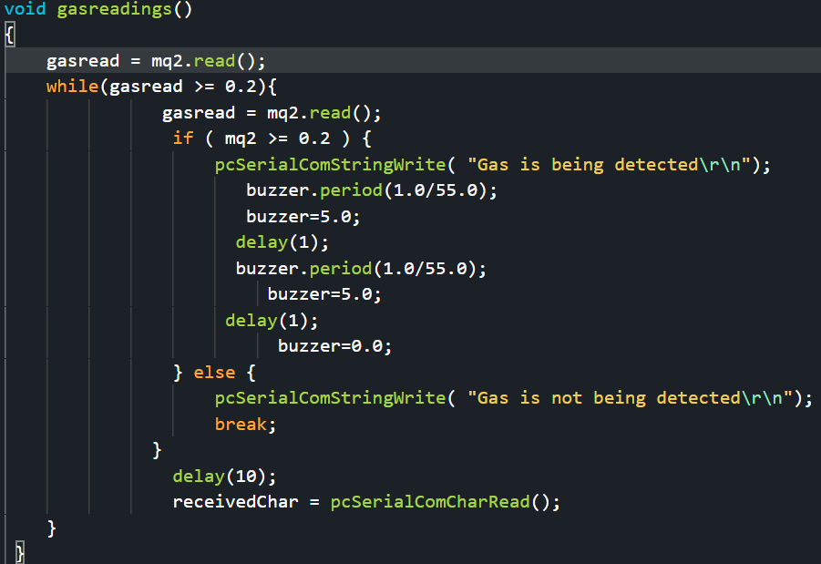
Results for Part:2
(Input only lab results, Git-hub code link, Flow chart, calculations or picture evidence of simulation/circuits/figures obtained).
All figures should be captioned with relevant title and a brief description to present the essential details).
By just adding the code for reading and outputting the potentiometer values and adding a second delay to make sure the user can read the values we can output both values continuesly.
Results for Part:3
(Input only lab results, Git-hub code link, Flow chart, calculations or picture evidence of simulation/circuits/figures obtained).
All figures should be captioned with relevant title and a brief description to present the essential details).
I had a few problems with the buzzer when adding into the loop for these outputs, so I created a function which seemed to fix the issue.
Results for Part:3
(Input only lab results, Git-hub code link, Flow chart, calculations or picture evidence of simulation/circuits/figures obtained).
All figures should be captioned with relevant title and a brief description to present the essential details).
This is the function for the part 3, as the buzzer did not work I wired it to the pmw output for the board, the gas sensor is also connected to a different pin as it is in the analog read pin making sure I can detect the intensity of the gas, this can be used later to create a more serious alarm depending on the intensity of the gas.

Slide 3
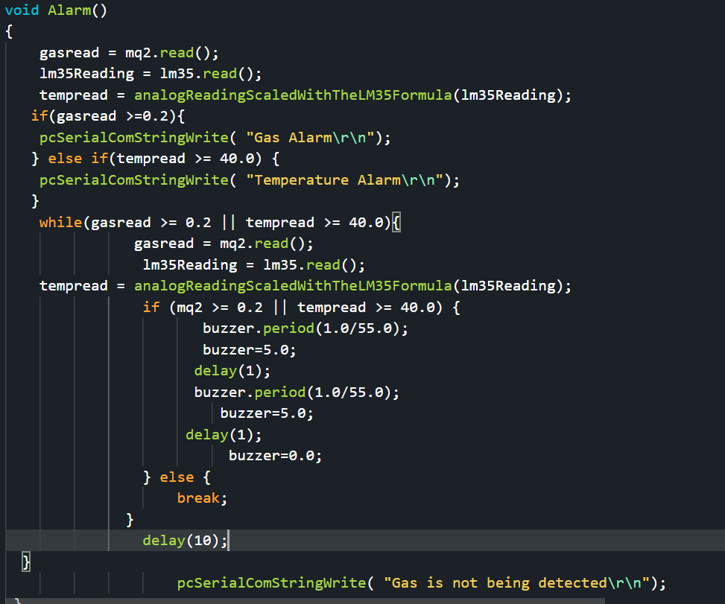
Results for Part:4
(Input only lab results, Git-hub code link, Flow chart, calculations or picture evidence of simulation/circuits/figures obtained).
All figures should be captioned with relevant title and a brief description to present the essential details).
For part 4 I decided to change the function into an alarm function, if the temperature raises above 40 degrees Celsius it will display that there is a temperature alarm as the buzzer stays on, if it is gas it will do the same, if no alarm is set it will display that the gas is not being detected as you can already see the temperature normally.
Results for Part:
(Input only lab results, Git-hub code link, Flow chart, calculations or picture evidence of simulation/circuits/figures obtained).
All figures should be captioned with relevant title and a brief description to present the essential details).
Results for Part:
(Input only lab results, Git-hub code link, Flow chart, calculations or picture evidence of simulation/circuits/figures obtained).
All figures should be captioned with relevant title and a brief description to present the essential details).

